Slide 1
Unit 1
Performance Parameters of Op Amp

Slide 2
Lesson Plan
Topic | Sub points | Book-Page Nos.
Technology Based classification of Op Amp | BJT, JFET, CMOS | TI PPT
OpAmp Parameters(DC) | Difference between ideal and practical Op Amp and its equivalent circuit.13 different DC Parameters | T1-109 T2-98 to 100
Effect of Temperature supply voltage and time on Parameters | Thermal Drift and Error voltage | T1-133
Op-amp Parameters(AC) | Frequency Response , Band width and slew Rate | T1-163,T2-120
Frequency Response of Op Amp | Compensated and Non compensated Op Amps. Closed loop and Open loop frequency response. Difference between bandwidth, transient Response and Slew Rate | T1-161
Stability and Offset Nulling Techniques |  | T1-111to122 T1-174

Slide 3
Op Amp Classification
Classification of Op-Amp
Based on Function:
General Purpose
Low input Current
Low Noise
Low Power
Low Drift
Wide Bandwidth
Single DC Supply
High Voltage
Multiple Devices
Based on manufacturing Technology
Bipolar
JFET
CMOS

Slide 4
Classification of Op Amp based on application
 | Opamp Type | Description | Example
1 | General Purpose | Internally Compensated and default choice for an application | 741
2 | Low input Current | Quiescent current needed is low. Typically uses MOSFET, JFET, Super Beta darlington transistors at input stage | LTC 2064
3 | Low Noise | Optimized to reduce internally generated noise | AD 795, OP27
4 | Low Power | Uses internal Circuitry to reduce power consumption | TLV 8541
5 | Low Drift | Devices are internally compensated to minimize drift due to temperature | ADA 4522
6 | Wide Bandwidth | Also called video Opamps and have very high gain bandwidth level | LF 351
7 | Single DC Supply | Designed to operate from single DC power supply | LM 158/258
8 | High Voltage | The power supply for these devices can be as high as 44V. | LM 143
9 | Multiple Devices | Two or Quad Arrangement in one IC | LM 324, LM148

Slide 5
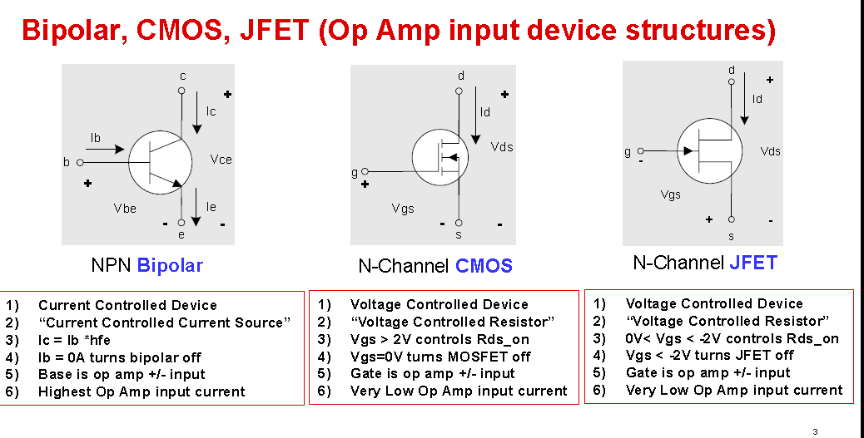
Depending on type of differential Amplifier at the input block of Op Amp there are three types of OpAmp

Slide 6
Classification of Op Amp based on technology
Sr. No | Parameter | Bipolar Op Amp | JFET Op Amp | CMOS Op Amp
1. | Differential Input Stage | Uses BJT | Uses JFET | Uses MOSFET
2. | Offset Voltage Vos | Smaller than JFET and CMOS | Larger than Bipolar | Larger than Bipolar
3. | Vos Drift | Linear | Larger than Bipolar | Larger than Bipolar
4. | Ib | Much Larger 100 nA | Low 1pA | Low 1pA
5. | Ib Drift | Small | Doubles every 10 degrees Celsius | Doubles every 10 degrees Celsius
6 | Broad Band Noise | Smaller and decreases with Ic | Slightly higher than bipolar | Larger than bipolar decreases to square root of ID
7 | Rail to Rail input | Not Common Difficult | yes | yes
8 | Rail to Rail Output | Close to rail 200 mV | Same as Bipolar | Very close to rail 10 mV

Slide 7
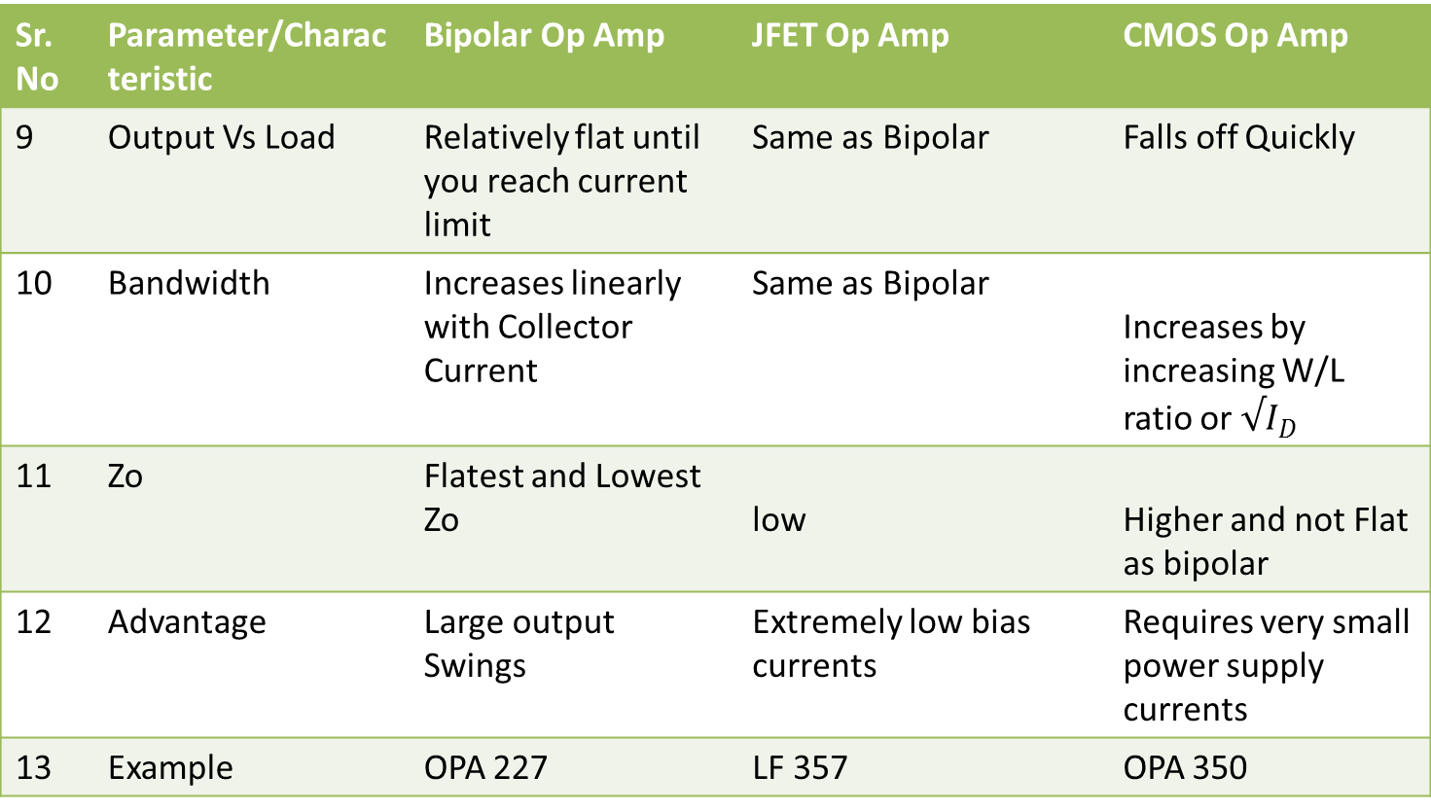
Classification of Op Amp based on technology Continued…
Sr. No | Parameter/Characteristic | Bipolar Op Amp | JFET Op Amp | CMOS Op Amp
9 | Output Vs Load | Relatively flat until you reach current limit | Same as Bipolar | Falls off Quickly
10 | Bandwidth | Increases linearly with Collector Current | Same as Bipolar | Increases by increasing W/L ratio or $√I_{D}$
11 | Zo | Flatest and Lowest Zo | low | Higher and not Flat as bipolar
12 | Advantage | Large output Swings | Extremely low bias currents | Requires very small power supply currents
13 | Example | OPA 227 | LF 357 | OPA 350

Slide 8
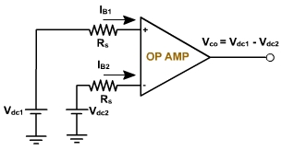
1. Input Offset Voltage:
Input offset voltage of Op-Amp Vio is the
Differential input voltage that exists between
Two input terminals of OpAmp with out any
External inputs applied.
Input offset voltage is also defined as the voltage that must be applied between the two input
terminals of an OPAMP to null or zero the output .fig shows that two dc voltages are applied to
input terminals to make the output zero.
Vio = Vdc1 – Vdc2
Vdc1 and Vdc2 are dc voltages and Rs represents the source resistance. Vio is the
difference of Vdc1 and Vdc2.
It may be positive or negative. For a 741C OPAMP the maximum value of Vio is 6mV.
It means a voltage ± 6 mV is required to one of the input to reduce the
output offset voltage to zero. The smaller the input offset voltage the better the
differential amplifier, because its transistors are more closely matched.

Slide 9
2. Output Offset Voltage:
Due to input offset voltage Vio output offset
Voltage Voo exists between output terminals of
Opamp.
It is caused by mismatch between input terminals
of opamp.The two transistors between input
differential stage do not have exactly similar characteristics
Hence collector currents in two transistors are not same.
Which causes differential output voltage from first stage.
The output of first stage is amplified by following stages
And aggrevates more mismatch in them.
Hence output offset voltage Voo is defined as output voltage caused by mismatching
between two input terminals.
Voo is DC voltage and it may be positive or negative

Slide 10
3. Input Bias Current:
As shown in figure both input terminals are
Grounded and no input is applied to opamp
The input bias current I_{B} is the average of the current entering
the input terminals of a balanced amplifier i.e.
I_{B} = (I_{B1} + I_{B2} ) / 2
IB1:DC bias current entering into non-inverting input
IB2: DC bias current entering into inverting input
For 741C I_{B(max)} = 700 nA and for precision 741C I_{B} = ± 7 nA

Slide 11
4. Input offset Current:
The input offset current I_{io} is the difference between the currents into inverting and
non-inverting terminals of a balanced amplifier.
I_{io} = | I_{B1} – I_{B2} |
The I_{io} for the 741C is 200nA maximum. As the matching between two input terminals
is improved, the difference between I_{B1} and I_{B2} becomes smaller, i.e. the I_{io} value decreases further. For a precision OPAMP 741C, I_{io} is 6 nA

Slide 12
5. Differential Input Resistance: (R_{i})
R_{i} is the equivalent resistance that can be measured at either the
inverting or non-inverting input terminal with the other terminal
grounded. For the 741C the input resistance is
relatively high 2 MΩ. For some OPAMP it may be up to 1000 G ohm.
6.Input Capacitance: (C_{i})
C_{i} is the equivalent capacitance that can be measured at
either the inverting and non-inverting terminal with the other
terminal connected to ground. A typical value of
C_{i} is 1.4 pf for the 741C.

Slide 13
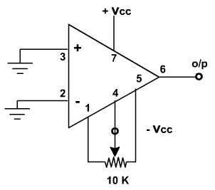
7.Offset Voltage Adjustment Range:
741 OPAMP have offset voltage null capability. Pins 1 and 5 are marked
offset null for this purpose. It can be done by connecting 10 K ohm pot
between 1 and 5 as shown in figure
By varying the potentiometer, output offset voltage
(with inputs grounded) can be reduced to zero volts.
Thus the offset voltage adjustment range is the
range through which the input offset voltage can be adjusted
by varying 10 K pot.
For the 741C the offset voltage adjustment range is ± 15 mV.

Slide 14
8. Input Voltage Range
Input voltage range is the range of a common mode input signal for which a
differential amplifier remains linear.
It is used to determine the degree of matching between the inverting and
non-inverting input terminals. For the 741C,
the range of the input common mode voltage is ± 13V maximum. This means that the
common mode voltage applied at both input terminals can be as high as +13V or as
low as –13V.
9. Common Mode Rejection Ratio­ (CMRR)..
.
CMRR is defined as the ratio of the differential voltage gain A_{d} to the common mode
voltage gain A_{CM}
CMRR = A_{d} / A_{CM}.
For the 741C, CMRR is 90 dB typically.
The higher the value of CMRR the better is the matching between two input terminals
and the smaller is the output common mode voltage.

Slide 15
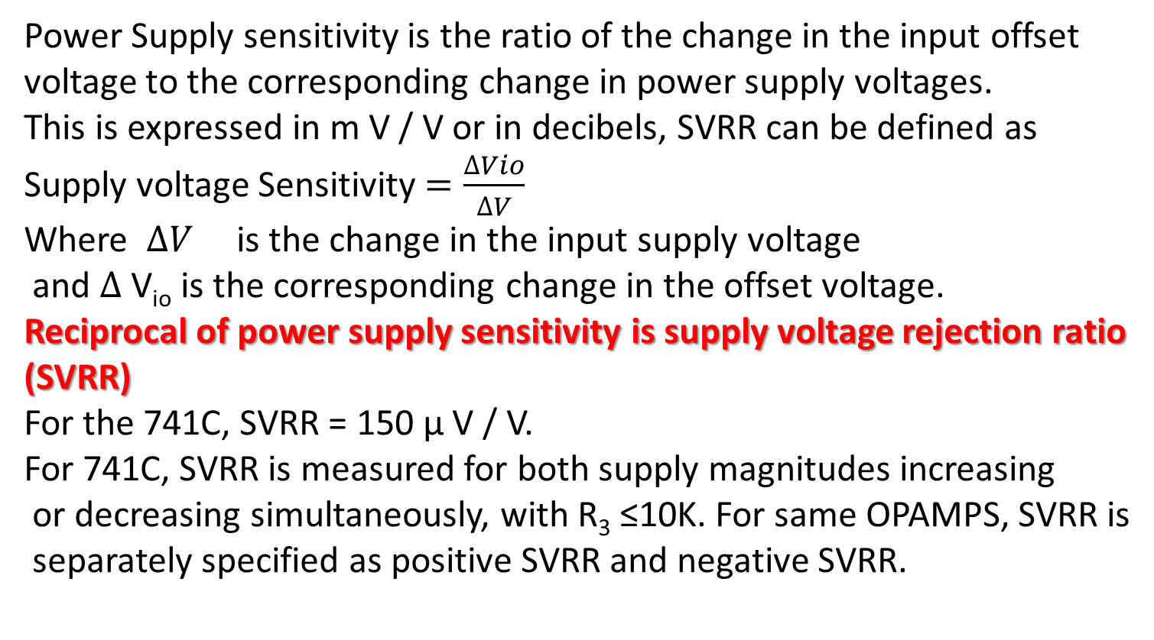
10. Supply voltage Rejection Ratio: (SVRR)/PSRR
Power Supply sensitivity is the ratio of the change in the input offset
voltage to the corresponding change in power supply voltages.
This is expressed in m V / V or in decibels, SVRR can be defined as
Supply voltage Sensitivity $=\frac{∆Vio}{∆V}$
Where $∆V$ is the change in the input supply voltage
and $∆$ V_{io} is the corresponding change in the offset voltage.
Reciprocal of power supply sensitivity is supply voltage rejection ratio
(SVRR)
For the 741C, SVRR = 150 µ V / V.
For 741C, SVRR is measured for both supply magnitudes increasing
or decreasing simultaneously, with R₃ ≤10K. For same OPAMPS, SVRR is
separately specified as positive SVRR and negative SVRR.

Slide 16
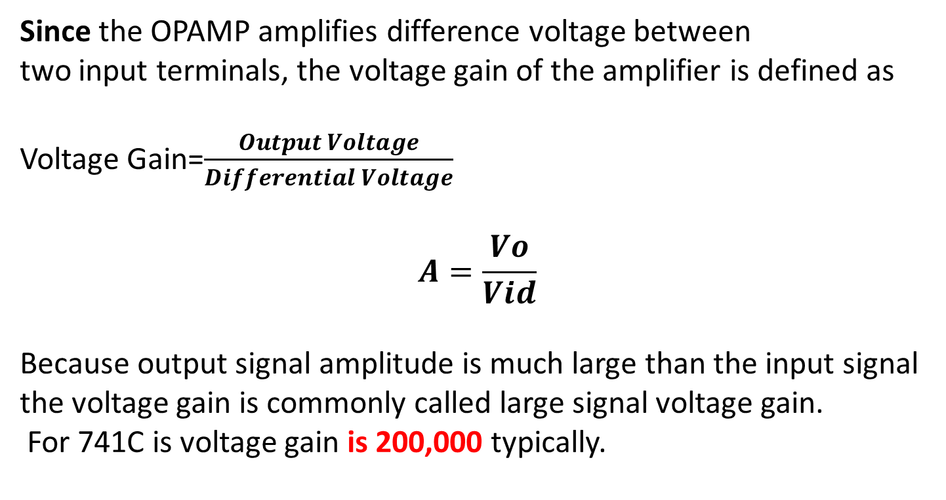
11. Large Signal Voltage Gain
Since the OPAMP amplifies difference voltage between
two input terminals, the voltage gain of the amplifier is defined as
Voltage Gain=$\frac{Output Voltage}{Differential Voltage}$
$$A=\frac{Vo}{Vid}$$
Because output signal amplitude is much large than the input signal
the voltage gain is commonly called large signal voltage gain.
For 741C is voltage gain is 200,000 typically.

Slide 17
12. Output voltage Swing:
The ac output compliance PP is the maximum unclipped peak to peak output voltage that an OPAMP can produce. Since the quiescent output is ideally zero, the ac output voltage can swing positive or negative. This also indicates the values of positive and negative saturation voltages of the OPAMP. The output voltage never exceeds these limits for a given supply voltages +V_{CC} and –V_{EE}. For a 741C it is ± 13 V.
13. Output Resistance: (Ro)
Ro is the equivalent resistance that can be measured between the output terminal of the OPAMP and the ground. It is 75 ohm for the 741C OPAMP.

Slide 18
14. Output Short circuit Current :
In some applications, an OPAMP may drive a load resistance that is approximately zero. Even its output impedance is 75 ohm but cannot supply large currents. Since OPAMP is low power device and so its output current is limited. The 741C can supply a maximum short circuit output current of only 25mA.
15. Supply Current :
I_{S} is the current drawn by the OPAMP from the supply. For the 741C OPAMP the supply current is 2.8 mA.
16. Power Consumption:
Power consumption (PC) is the amount of quiescent power (v_{in}= 0V) that must be consumed by the OPAMP in order to operate properly. The amount of power consumed by the 741C is 85 m W.

Slide 19
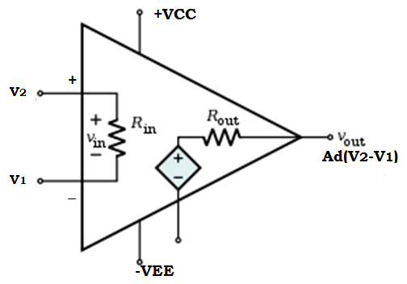
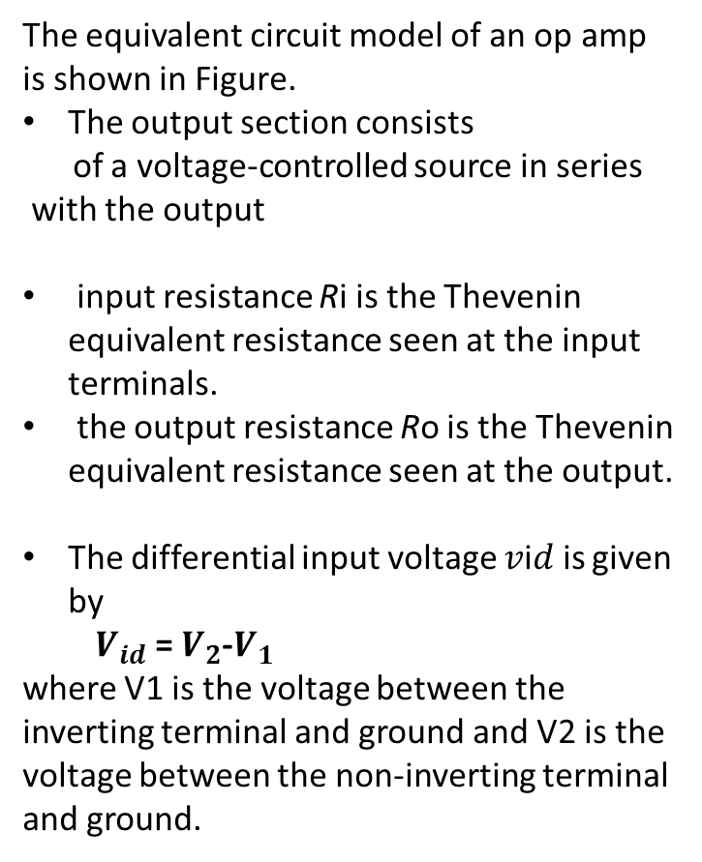
Equivalent Circuit of Non Ideal Op Amp
The equivalent circuit model of an op amp
is shown in Figure.
The output section consists
of a voltage-controlled source in series
with the output
input resistance Ri is the Thevenin equivalent resistance seen at the input terminals.
the output resistance Ro is the Thevenin equivalent resistance seen at the output.
The differential input voltage 𝑣i𝑑 is given by
${ V}_{id}$= $V_{2}$-$V_{1}$
where V1 is the voltage between the inverting terminal and ground and V2 is the voltage between the non-inverting terminal and ground.
Figure :Ideal Op Amp
Equivalent Circuit

Slide 20
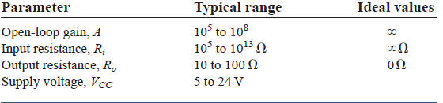
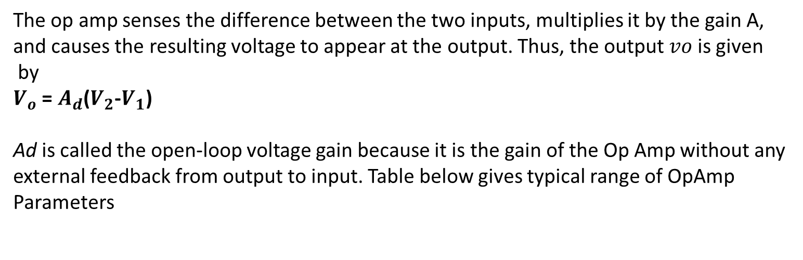
Equivalent Circuit of Op Amp
The op amp senses the difference between the two inputs, multiplies it by the gain A,
and causes the resulting voltage to appear at the output. Thus, the output 𝑣𝑜 is given
by
$V_{o}$ = $A_{d}$($V_{2}$-$V_{1}$)
Ad is called the open-loop voltage gain because it is the gain of the Op Amp without any
external feedback from output to input. Table below gives typical range of OpAmp
Parameters

Slide 21
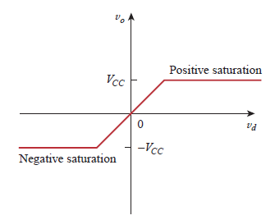
Ideal voltage Transfer Curve
A practical limitation of the op amp is that the magnitude of its output voltage cannot
exceed |VCC|. In other words, the output voltage is dependent on
and is limited by the power supply voltage. Figure 1.4 illustrates that the opamp can
operate in three modes, depending on the differential input voltage vid:
Positive saturation, V𝑜=𝑉𝑐𝑐.
2. Linear region, −𝑉𝑐𝑐≤V𝑜=A𝑉i𝑑≤𝑉𝑐𝑐.
3. Negative saturation, V𝑜=−𝑉EE .
If we attempt to increase vid beyond the
linear range, the op amp becomes saturated and
yields 𝑣𝑜=𝑉𝑐𝑐 or 𝑣𝑜=−𝑉𝑐𝑐. Here, we will assume
that our op amps operate in the linear mode.
This means that the output voltage is restricted by
−𝑉𝑐𝑐≤ Vo ≤𝑉𝑐𝑐

Slide 22
Numerical on DC PSRR/SVRR
For certain opamp PSRR is 70dB. What is numerical value of PSRR.
For 741 opamp supply voltage rejection ratio is 150µV/V. Calculate change in opamps input offset voltage Vio if supply voltages are varied from ±10V to ±12V.
For certain opamp change in opamp’s input offset voltage Vio caused by variation in supply voltage is 60µV. Determine change in supply voltages. Assume that SVRR for opamp is 104dB.

Slide 23
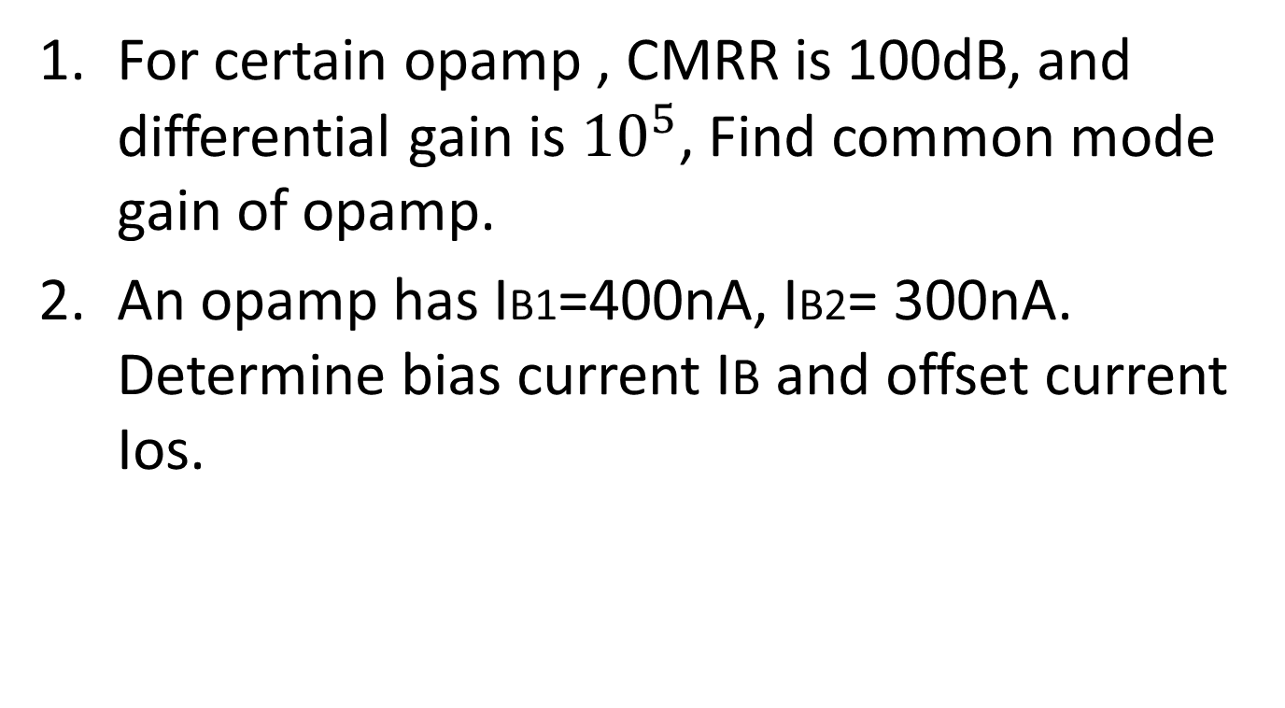
Numerical
For certain opamp , CMRR is 100dB, and differential gain is ${10}^{5}$, Find common mode gain of opamp.
An opamp has IB1=400nA, IB2= 300nA. Determine bias current IB and offset current Ios.

Slide 24
AC Parameters of Op-Amp
Frequency Response , Band width and slew Rate

Slide 25
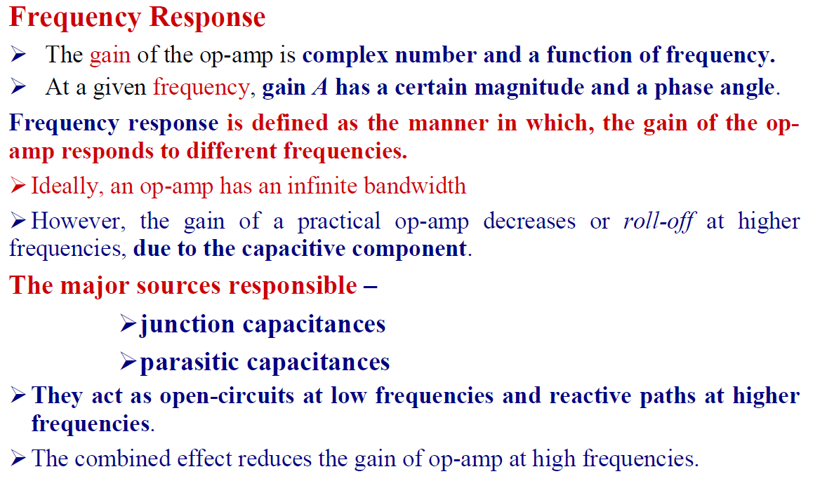
Op-amp Frequency Response

Slide 26
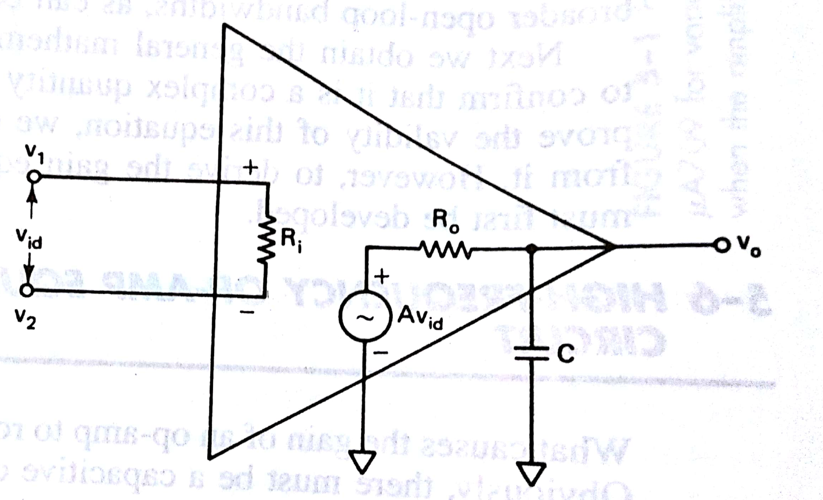
High frequency model of
opamp with single break
frequency
The capacitive component in the equivalent circuit causes decrease in gain as frequency increases.
Two Major sources of capacitive effects are junction and parasitic capacitances and effectively shown as C .

Slide 27
Two major sources responsible for capacitor C in high frequency model
Physical Characteristics of semiconductor devices: As Op Amp is made up of BJTs and FETs the junction capacitances of these devices become dominant at high frequency.
Internal Construction of Op Amp: All resistors transistors and some times capacitors are integrated on single substrate. Substrate acts as insulator and separates these components. The components are connected by conducting paths. These conducting paths separated by substrate act as capacitor.
Op Amp with single break frequency is represented by one capacitor in the model.

Slide 28
Compensating Networks
For Op Amps as the operating frequency increases ,two effects become evident.
The gain (magnitude ) of amplifier decreases
The phase shift between the output and input increases.
The change in phase and magnitude is attributed to internally integrated capacitors as well as stray capacitances. These capacitances are due to physical characteristics of Semiconductor devices(BJTs and FETs)and the internal construction of the Op Amp
The rate of change of gain as well as the phase shift of an Op Amp
can be changed by using specific components.
The most common components are Resistors and capacitors
Network formed by such components and used for modifying gain and phase shift are called compensating networks

Slide 29
Compensating Networks
Two common types of compensating networks are
Phase lead :Negative Phase Angle
Phase lag :Positive phase angle
First generation Op Amps used external compensating networks.
Later Generation of Op Amps use internal compensating network.
Therefore there are two types of Op Amps
Internally Compensated (741)
Externally Compensated (709)

Slide 30
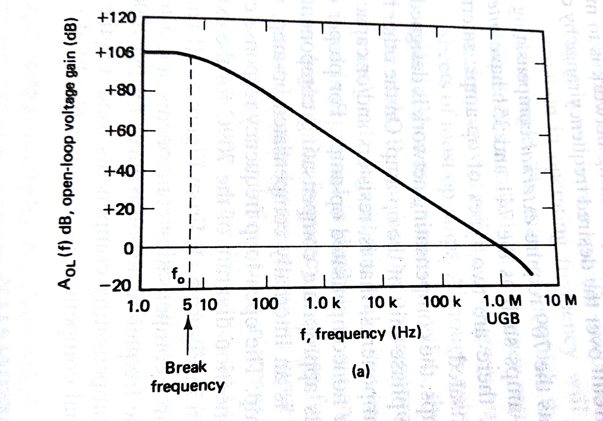
Frequency Response of internally compensated Op Amp(741)
Frequency Response of 741 C Internally compensated Op Amp has unity gain bandwidth of
1 MHz and single break frequency fo before unity gain bandwidth
At break frequency
The open loop gain
Is down 3dB or 0.707
of its value at 0 Hz dc.
Gain of opamp remains Constant till break frequency.
The gain rolls off at the rate 20 db per decade after fo .
For 741 C break frequency is 5 Hz

Slide 31
Frequency Response of internally compensated Op Amp
In 741 Op Amp 30 pf capacitor is internal compensating component.
It controls open loop gain to allow it to roll off at a rate of
20 dB /decade.
Internally compensated Op Amps have very small open
loop bandwidth.
They are simply called compensated Op Amps

Slide 32
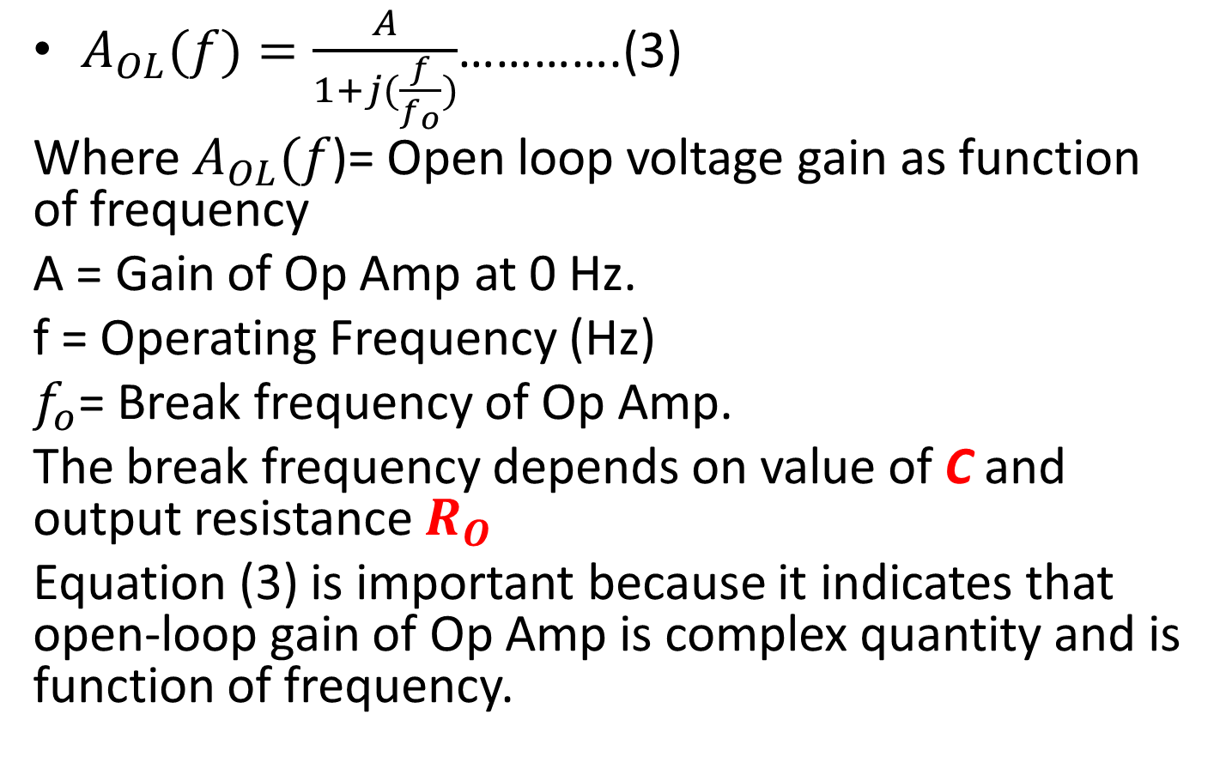
Open loop voltage gain as a function of frequency
$A_{OL}(f)=\frac{A}{1+j(\frac{f}{f_{o}})}$………….(3)
Where $A_{OL}(f$)= Open loop voltage gain as function of frequency
A = Gain of Op Amp at 0 Hz.
f = Operating Frequency (Hz)
$f_{o}$= Break frequency of Op Amp.
The break frequency depends on value of C and output resistance $R_{O}$
Equation (3) is important because it indicates that open-loop gain of Op Amp is complex quantity and is function of frequency.

Slide 33
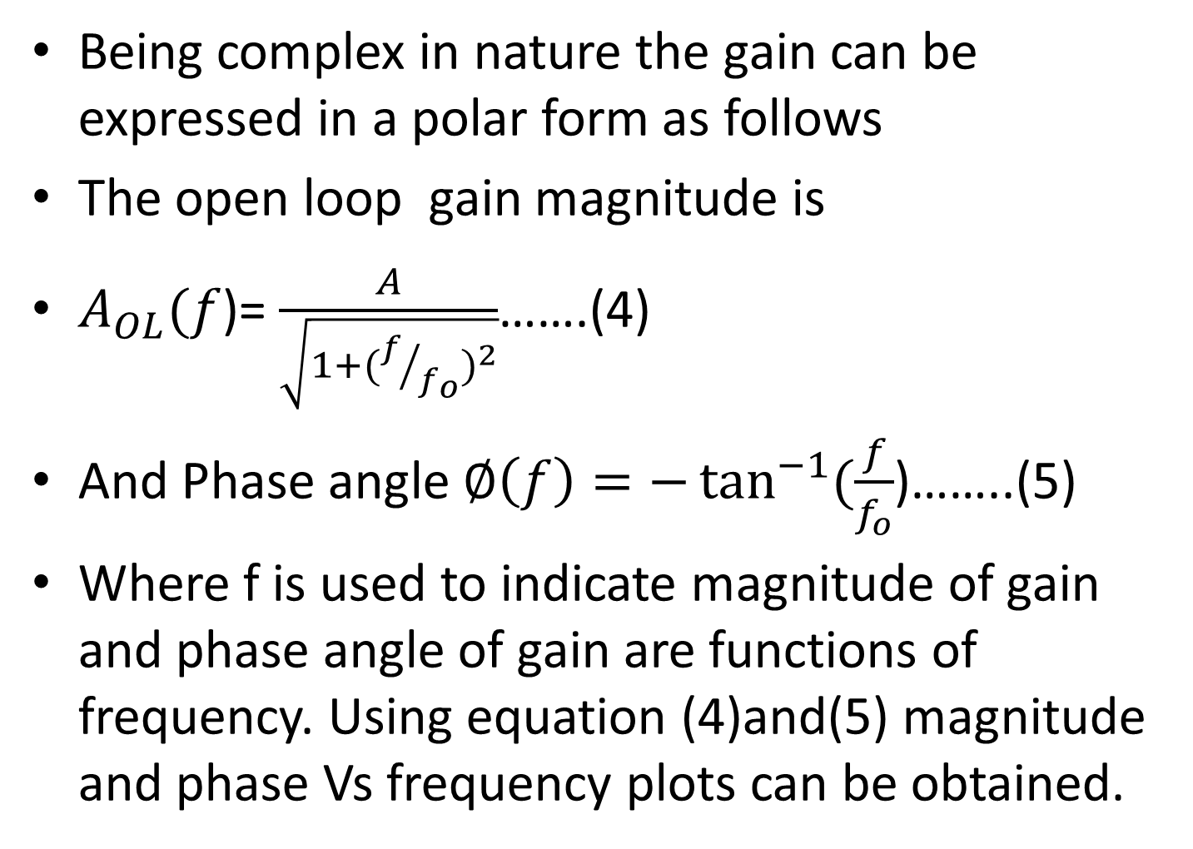
Open loop voltage gain of OPAMP as a function of frequency
Being complex in nature the gain can be expressed in a polar form as follows
The open loop gain magnitude is
$A_{OL}(f$)= $\frac{A}{\sqrt{1+({f/{f_{o}})}^{2}}}$…….(4)
And Phase angle $∅\left(f\right)=−\tan^{−1}{(\frac{f}{f_{o}}}$)……..(5)
Where f is used to indicate magnitude of gain and phase angle of gain are functions of frequency. Using equation (4)and(5) magnitude and phase Vs frequency plots can be obtained.

Slide 34
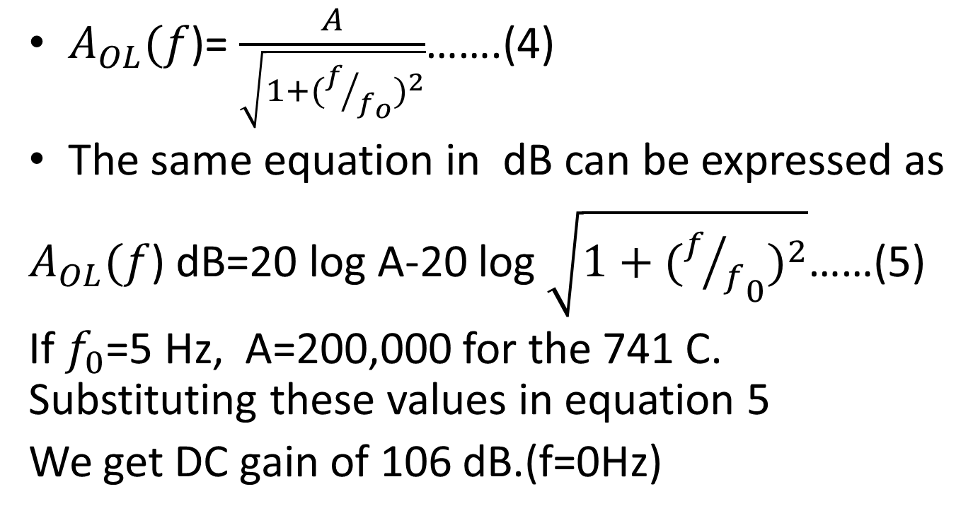
Open loop voltage gain as a function of frequency
$A_{OL}(f$)= $\frac{A}{\sqrt{1+({f/{f_{o}})}^{2}}}$…….(4)
The same equation in dB can be expressed as
$A_{OL}(f$) dB=20 log A-20 log $\sqrt{1+({{f/f}_{0})}^{2}}$……(5)
If $f_{0}$=5 Hz, A=200,000 for the 741 C. Substituting these values in equation 5
We get DC gain of 106 dB.(f=0Hz)

Slide 35
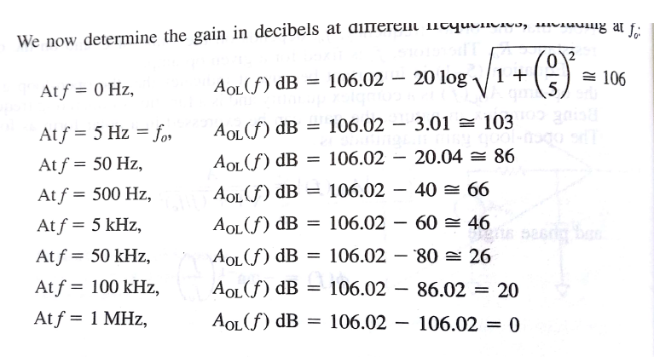
Gain in decibel at different frequencies , including at $f_{0}$

Slide 36
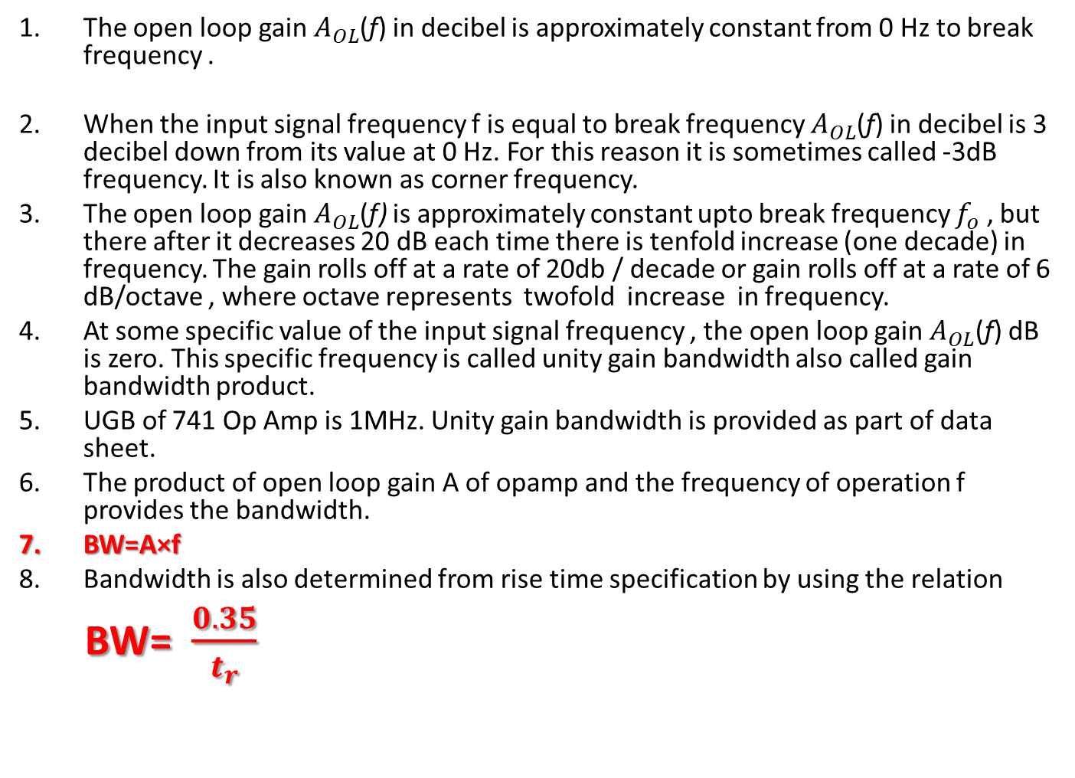
Observations from gain Calculations
The open loop gain $A_{OL}$(f) in decibel is approximately constant from 0 Hz to break frequency .
When the input signal frequency f is equal to break frequency $A_{OL}$(f) in decibel is 3 decibel down from its value at 0 Hz. For this reason it is sometimes called -3dB frequency. It is also known as corner frequency.
The open loop gain $A_{OL}$(f) is approximately constant upto break frequency $f_{o}$ , but there after it decreases 20 dB each time there is tenfold increase (one decade) in frequency. The gain rolls off at a rate of 20db / decade or gain rolls off at a rate of 6 dB/octave , where octave represents twofold increase in frequency.
At some specific value of the input signal frequency , the open loop gain $A_{OL}$(f) dB is zero. This specific frequency is called unity gain bandwidth also called gain bandwidth product.
UGB of 741 Op Amp is 1MHz. Unity gain bandwidth is provided as part of data sheet.
The product of open loop gain A of opamp and the frequency of operation f provides the bandwidth.
BW=A×f
Bandwidth is also determined from rise time specification by using the relation
BW= $\frac{0.35}{t_{r}}$

Slide 37
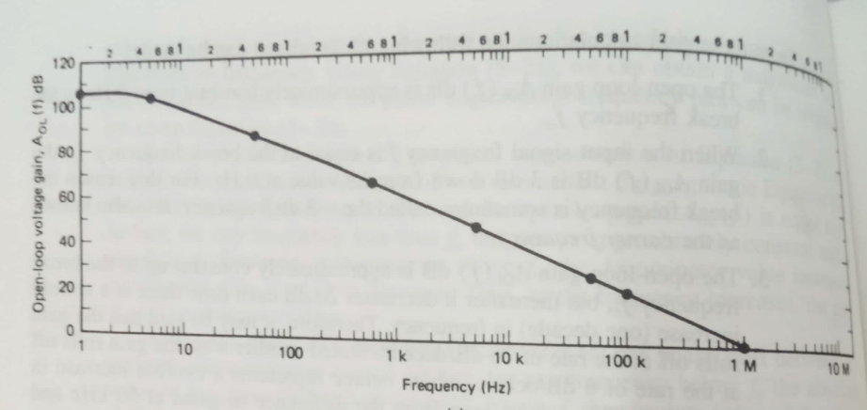
Gain in decibels vs Frequency for 741 Op Amp

Slide 38
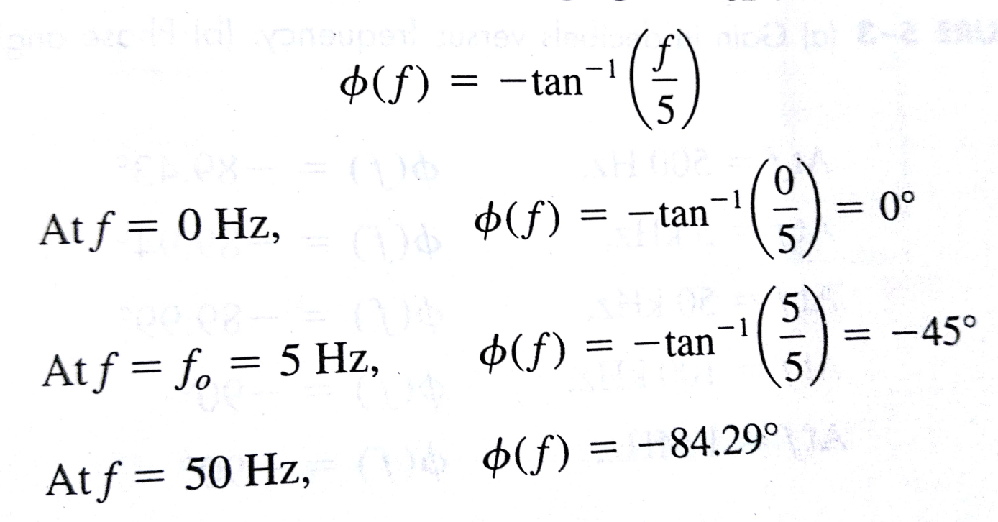
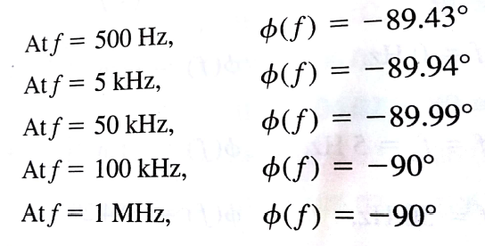
Phase Angles at various frequencies for 741 Op Amp

Slide 39
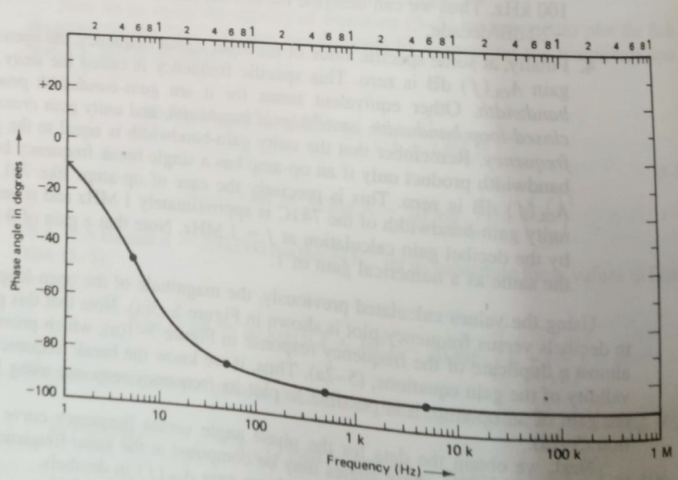
Phase Vs Frequency for 741 Op Amp

Slide 40
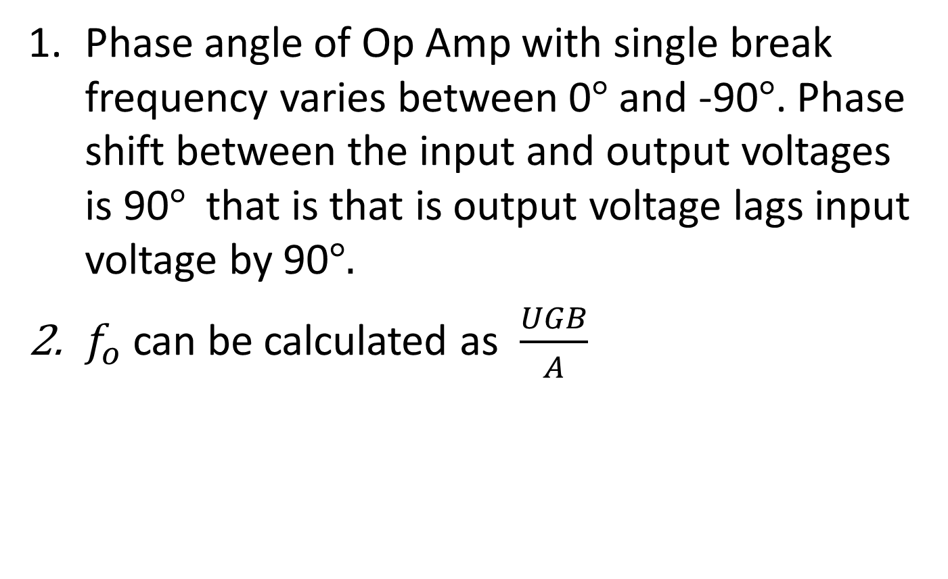
Observations from Phase Plot
Phase angle of Op Amp with single break frequency varies between 0$°$ and -90$°$. Phase shift between the input and output voltages is 90$°$that is that is output voltage lags input voltage by 90$°.$
$f_{o}$ can be calculated as $\frac{UGB}{A}$

Slide 41
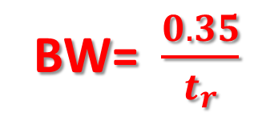
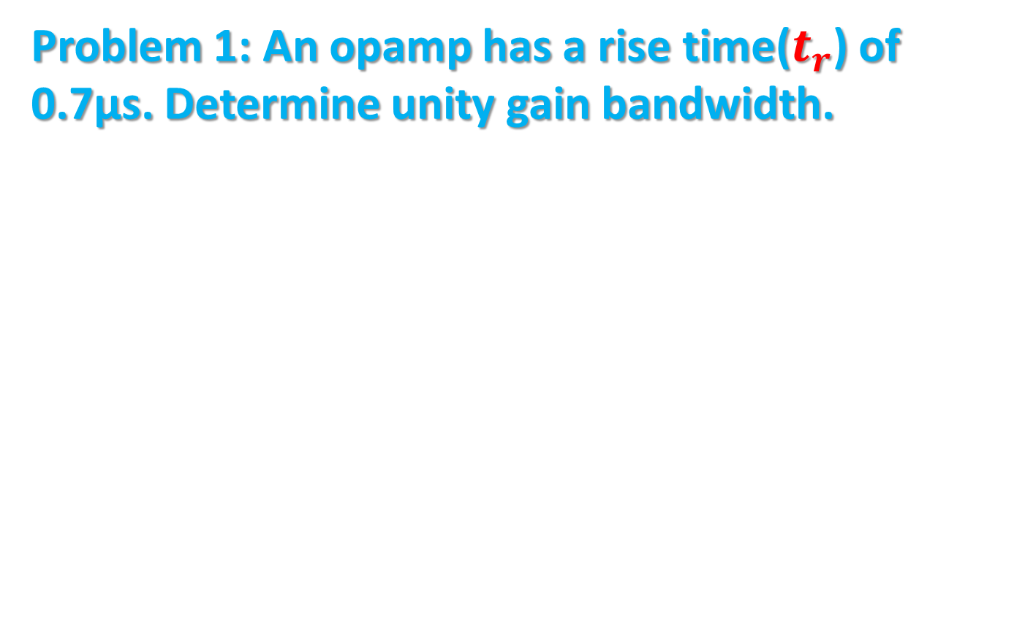
Numerical
Problem 1: An opamp has a rise time($t_{r}$) of 0.7µs. Determine unity gain bandwidth.
BW= $\frac{0.35}{t_{r}}$
Ans:500KHz

Slide 42
Limitations of Op Amp Open loop configuration
In open loop configurations due to high gain of Op Amp, clipping of output waveform can occur when output exceeds saturation level of Op Amp.
This feature actually makes it possible to amplify very low frequency signal of the order of microvolts or even less and amplification can be achieved accurately without any distortion. However , signals of such magnitudes are susceptible to noise and amplification from those applications is almost impossible to obtain in laboratory

Slide 43
Limitations of Op Amp Open loop configuration
Open loop gain of Op Amp is not a constant and varies with temperature and variations in power supply.
The bandwidth of open loop Op amps is negligibly small. This makes open loop configuration of Op Amp unsuitable for AC applications open loop bandwidth of 741 is only 5 Hz but in almost all AC applications bandwidth requirement is very large.

Slide 44
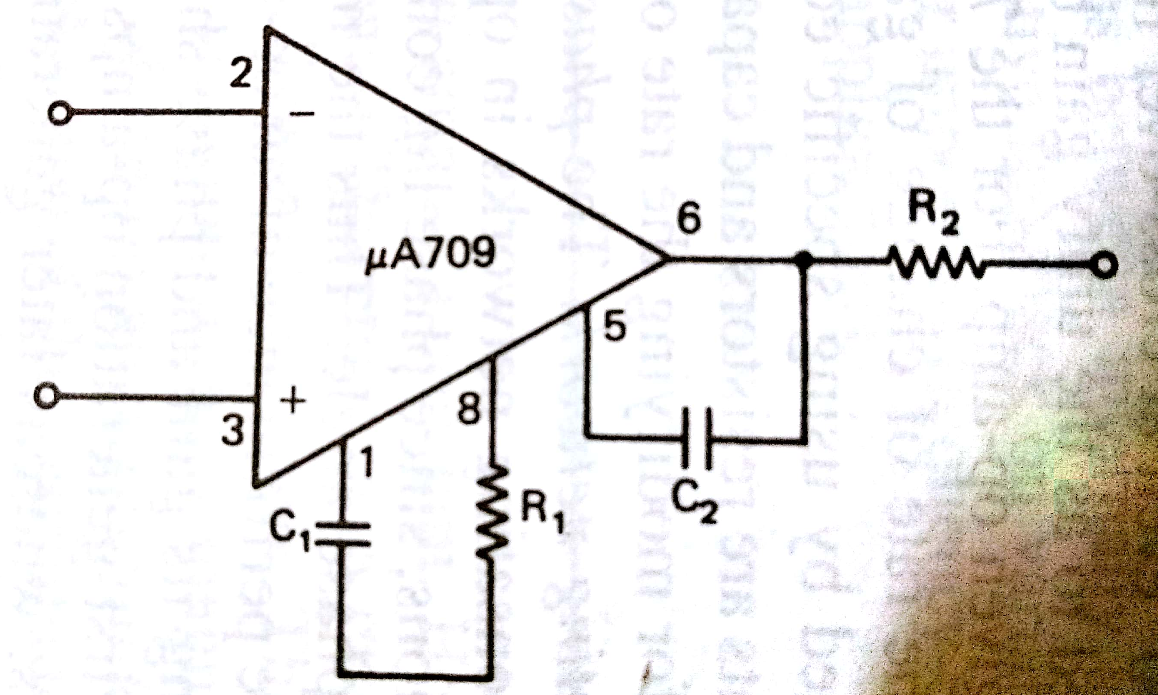
Frequency Response of Non-compensated Op Amps
Op Amps requiring external compensating components are called non compensated
Op Amps.
Also called tailored frequency response Op Amp.
C1, C2, R1 decide frequency response of 709

Slide 45
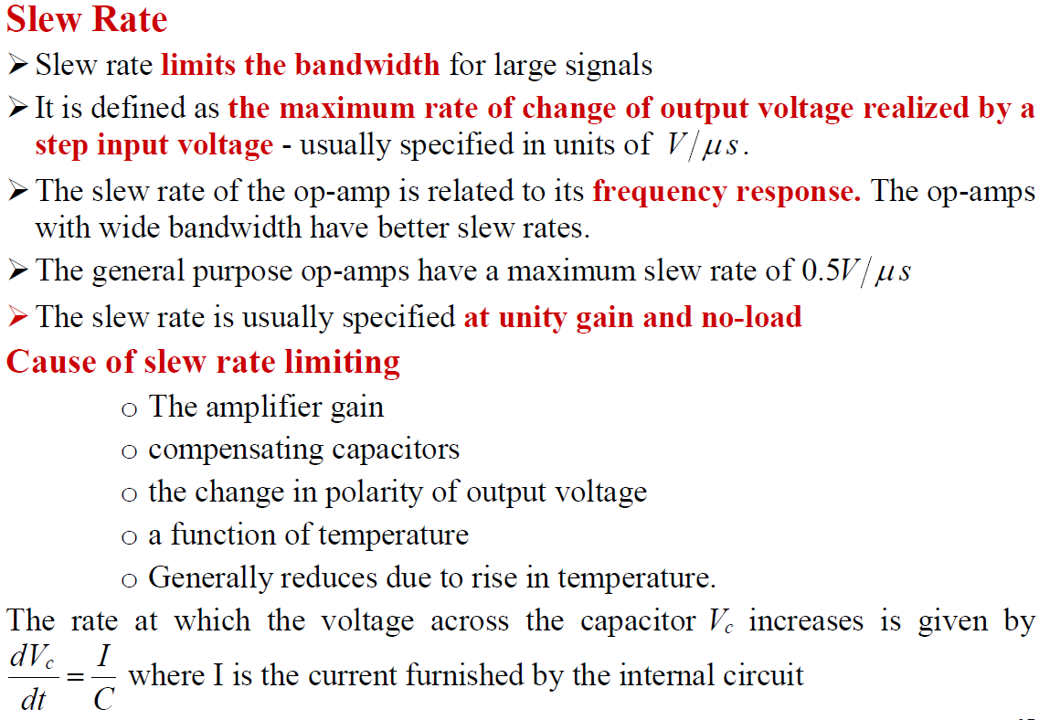

Slide 46
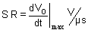
Slew Rate
Slew Rate: Slew rate is defined as the maximum rate of change of output voltage per unit of time under large signal conditions and is expressed in volts / µ secs.
Slew rate indicates how rapidly the output of an OPAMP can change in response to changes in the input frequency with input amplitude constant. The slew rate changes with change in voltage gain
If the slope requirement is greater than the slew rate, then distortion occurs. For the 741C the slew rate is low 0.5 V / µS. which limits its use in higher frequency applications.

Slide 47
Slew Rate
Slew rate of Op Amp is related to its frequency response .
The Op Amps with wide bandwidth have better slew rate.
It is determined by number of factors such as amplifier gain , compensating capacitors and the change in polarity of output voltage.
It is also function of temperature and reduces due to rise in temperature.

Slide 48
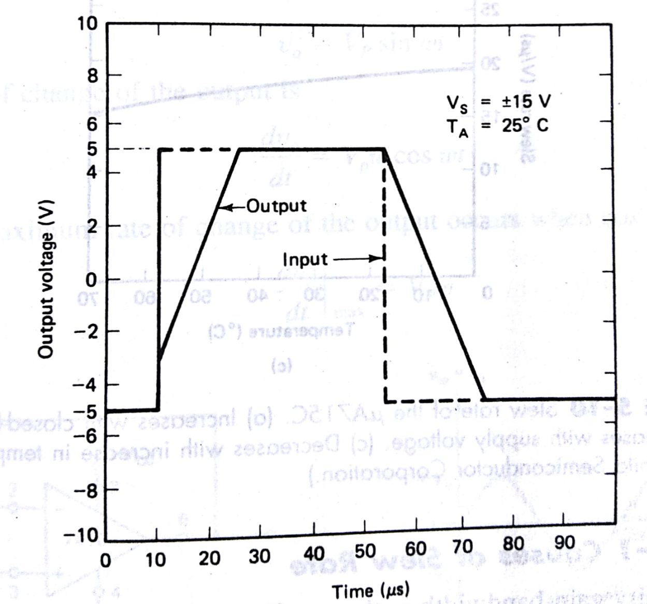
Slew rate specified as Voltage follower large-signal Pulse Response

Slide 49
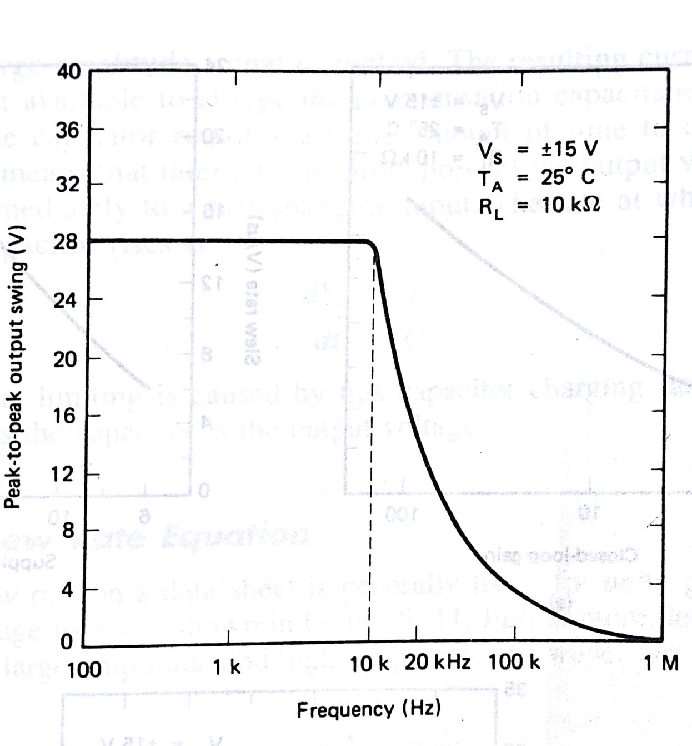
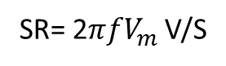
Specifying Slew Rate indirectly
SR= 2$πfV_{m}$ V/S
Specified as peak to peak output voltage swing as a function of frequency

Slide 50
Slew Rate limiting of Sine Wave

Slide 51
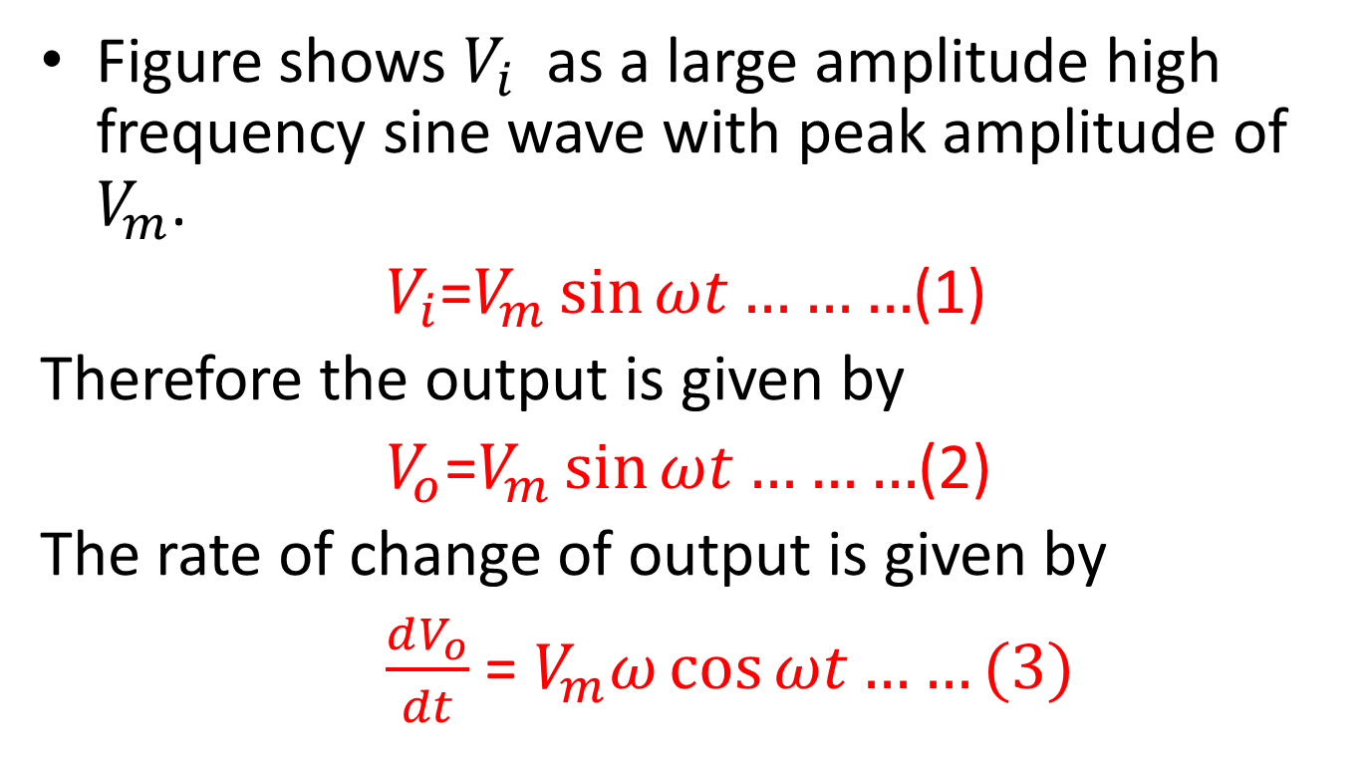
Slew Rate limiting of Sine Wave
Figure shows $V_{i}$ as a large amplitude high frequency sine wave with peak amplitude of $V_{m}$.
$V_{i}$=$V_{m}\sin{ωt………}$(1)
Therefore the output is given by
$V_{o}$=$V_{m}\sin{ωt………}$(2)
The rate of change of output is given by
$\frac{dV_{o}}{dt}$ = $V_{m}ω\cos{ωt……(3)}$

Slide 52
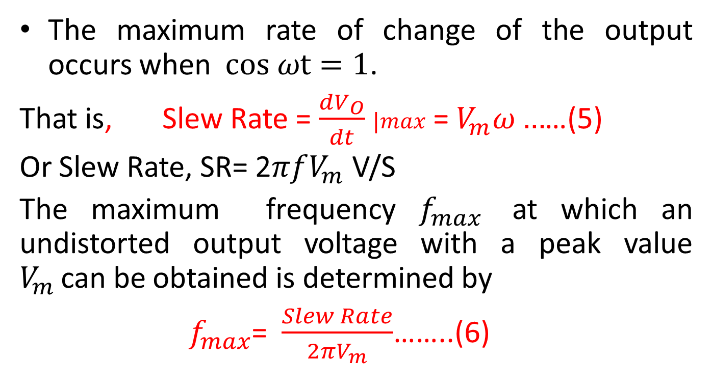
Slew Rate limiting of Sine Wave
The maximum rate of change of the output occurs when $cos ωt=1$.
That is, Slew Rate = $\frac{dV_{O}}{dt}$ $|max$ = $V_{m}ω…$…(5)
Or Slew Rate, SR= 2$πfV_{m}$ V/S
The maximum frequency $f_{max}$ at which an undistorted output voltage with a peak value $V_{m }$can be obtained is determined by
${ f}_{max}$= $\frac{Slew Rate}{2πV_{m}}$……..(6)

Slide 53
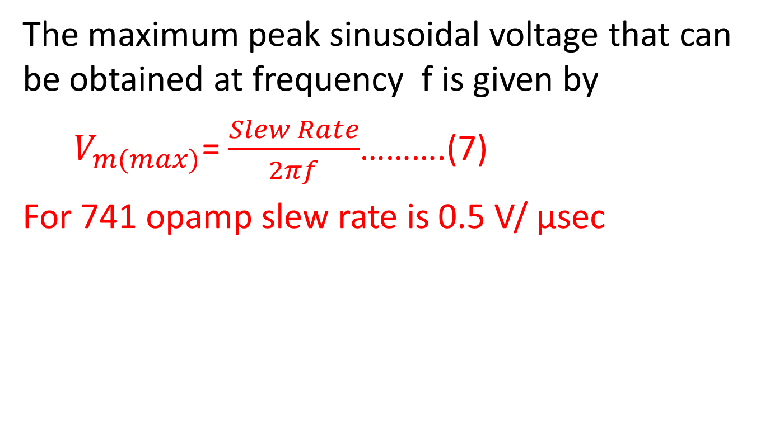
Slew Rate limiting of Sine Wave
The maximum peak sinusoidal voltage that can be obtained at frequency f is given by
$V_{m(max)}$= $\frac{Slew Rate}{2πf}$……….(7)
For 741 opamp slew rate is 0.5 V/ µsec

Slide 54
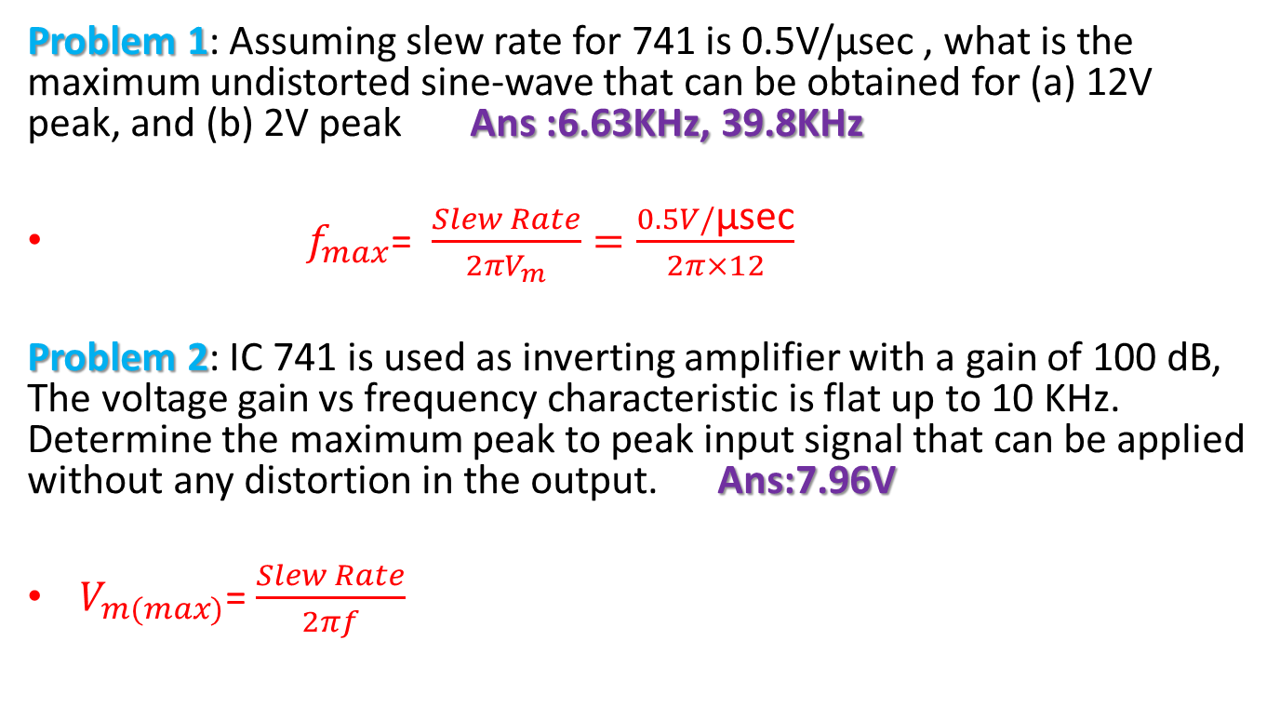
Slew Rate limiting of Sine Wave
Problem 1: Assuming slew rate for 741 is 0.5V/µsec , what is the maximum undistorted sine-wave that can be obtained for (a) 12V peak, and (b) 2V peak Ans :6.63KHz, 39.8KHz
${ f}_{max}$= $\frac{Slew Rate}{2πV_{m}}=\frac{0.5V/\text{µ}\text{sec}}{2π×12}$
Problem 2: IC 741 is used as inverting amplifier with a gain of 100 dB, The voltage gain vs frequency characteristic is flat up to 10 KHz. Determine the maximum peak to peak input signal that can be applied without any distortion in the output. Ans:7.96V
$V_{m(max)}$= $\frac{Slew Rate}{2πf}$

Slide 55
Comparison of AC Parameters of Opamp
Sr No | Bandwidth | Transient response (Rise Time tr) | Slew RATE
1 | A small signal phenomenon | A small signal Phenomenon | A large signal phenomenon
2 | Band of frequencies for which gain remains constant | That part of the total response before the response reaches steady state | The maximum time rate of change of output voltage
3 | Depends on compensating components and closed loop gain | Composed of overshoot and rise time | Slew rate limiting depends on both frequency and amplitude often increases with closed loop gain and power supply voltages
4 | If exceeded , results in reduction of output voltage | Affects settling time | If Exceeded results in distortion

Slide 56
A list of parameters that must be considered for AC and DC Applications
Sr. no. | For AC APPLICATIONS Consider | For DC Applications Consider
1. | Input Resistance | Input Resistance
2. | Output Resistance | Output Resistance
3. | Large Signal Voltage Gain | Large Signal Voltage Gain
4. | Output Voltage Swing | Output Voltage Swing
5. | Average Input Offset Voltage and current drifts | Input Offset Voltage and current drifts
6. | Long-Term input offset voltage stability | Long-Term input offset voltage stability
7. | Transient Response, Slew Rate , Equivalent input noise voltage and current | -

Slide 57
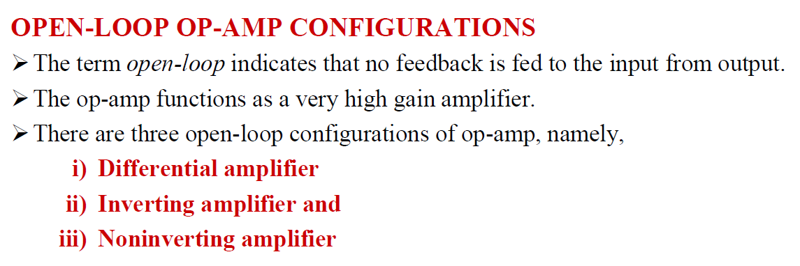

Slide 58
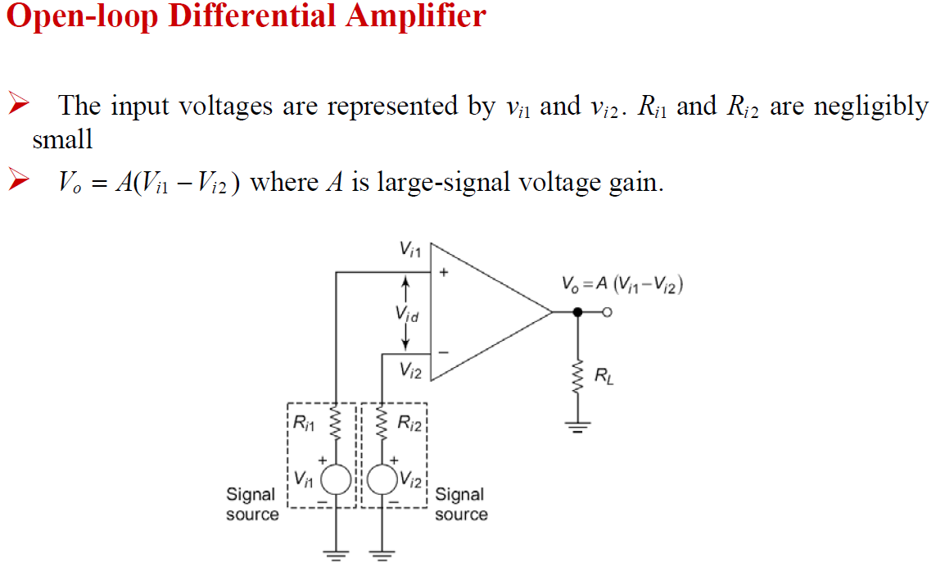

Slide 59
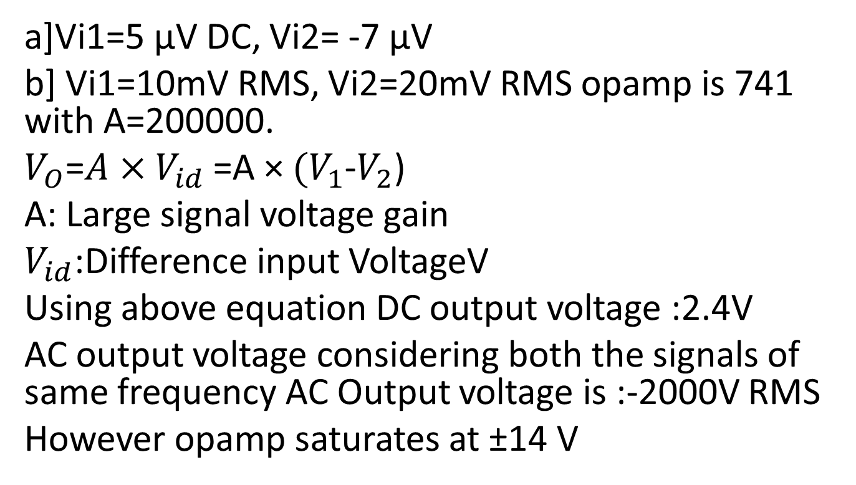
Determine the output voltage in each of following cases for open loop differential amplifier
a]Vi1=5 µV DC, Vi2= -7 µV
b] Vi1=10mV RMS, Vi2=20mV RMS opamp is 741 with A=200000.
$V_{O}$=$A×V_{id}$ =A × ${(V}_{1}$-$V_{2}$)
A: Large signal voltage gain
$V_{id}$:Difference input VoltageV
Using above equation DC output voltage :2.4V
AC output voltage considering both the signals of same frequency AC Output voltage is :-2000V RMS
However opamp saturates at ±14 V

Slide 60
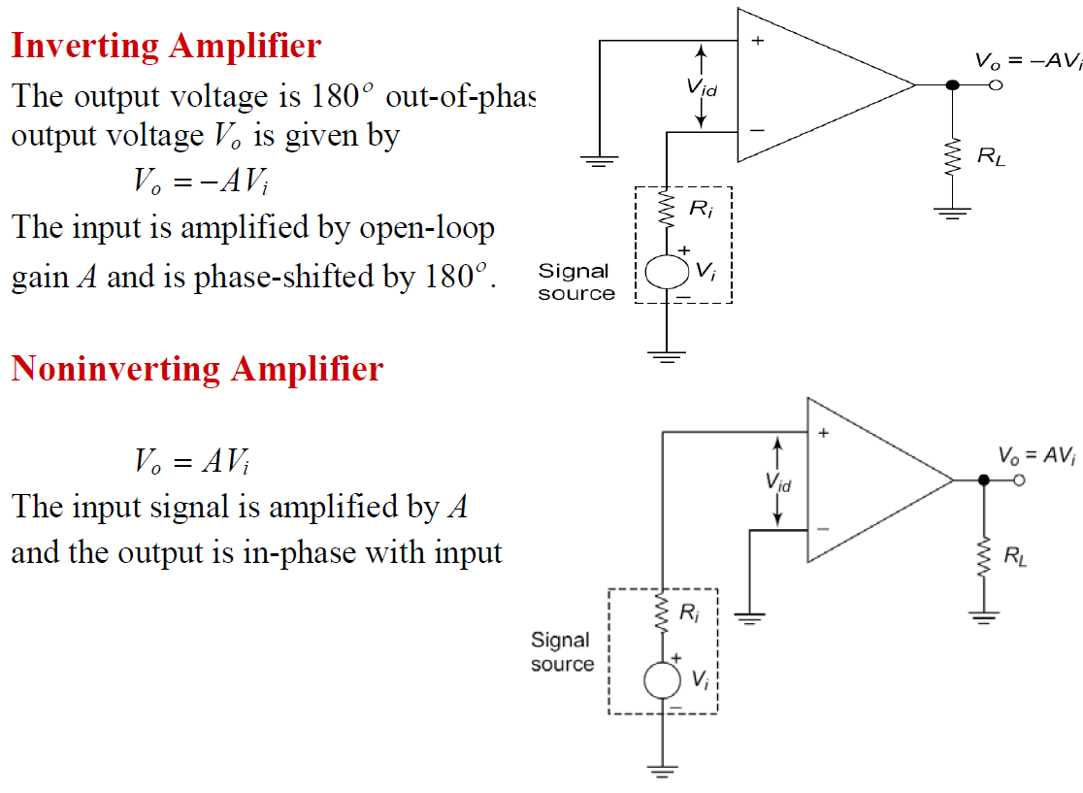

Slide 61
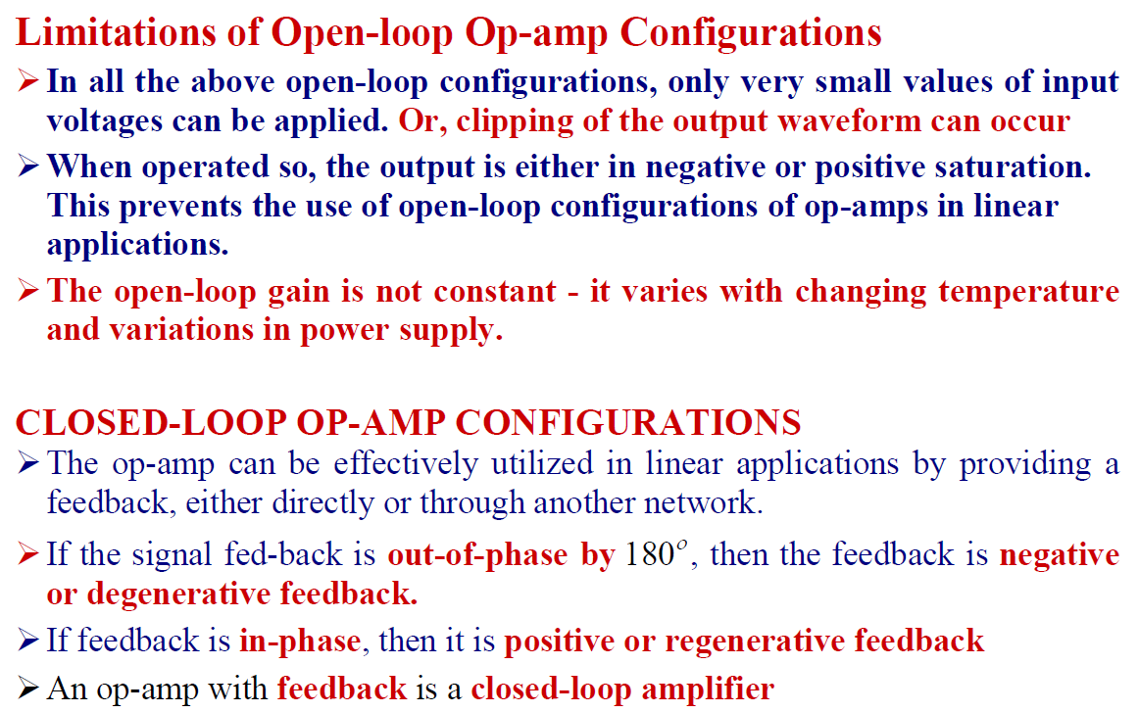
*Benefits of negative feedback: decrease in harmonic or nonlinear distortion, reduction in the effect of input offset voltage at the output, also reduces effect of variation in temperature and supply voltages on output of Op-amp

Slide 62
Closed loop Op Amp
As open loop gain of Op Amp is very high only the smaller signals of microvolts or less can be amplified.
For the reasons mentioned earlier in slide no 44 and 45 open loop Op Amp is not used in linear applications.
We can select as well as control the gain of the Op Amp if we introduce the modification in the basic circuit
Hence Op Amp may be used with Negative Feedback.

Slide 63
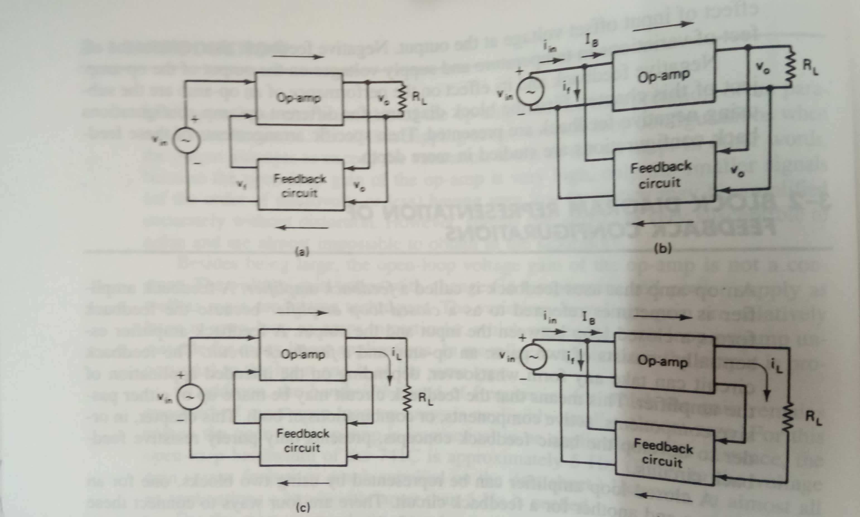
Closed loop Op Amp Configurations
Voltage Series
Voltage Shunt
Current Series
Current Shunt

Slide 64
Closed loop Op Amp Configurations
Out of four topologies two commonly used topologies for Op Amp are
Voltage Series (Used in Non Inverting Configuration)
Voltage Shunt(Used in inverting configuration)

Slide 65
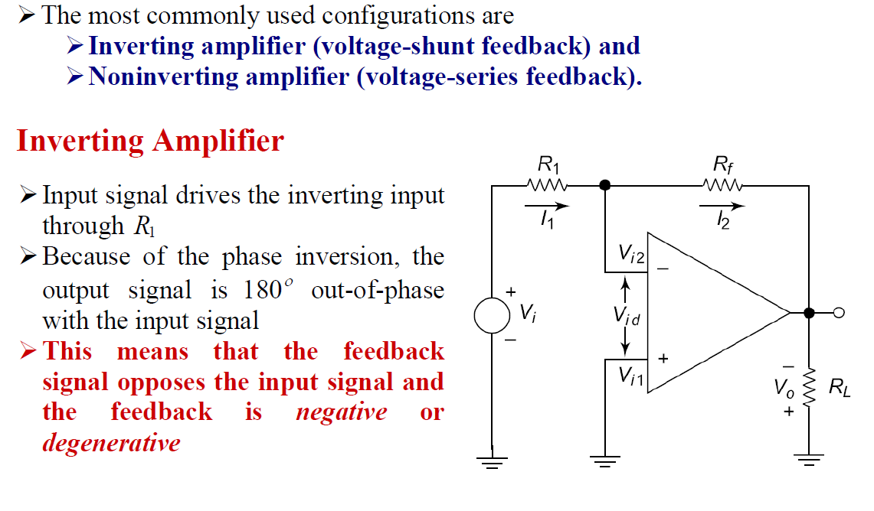

Slide 66
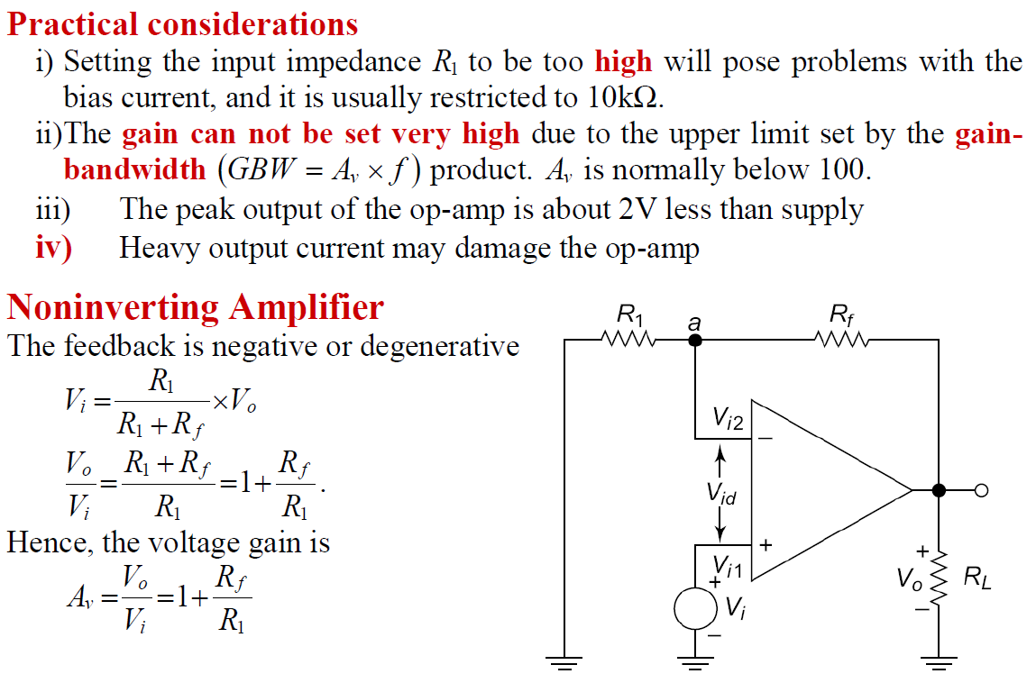

Slide 67
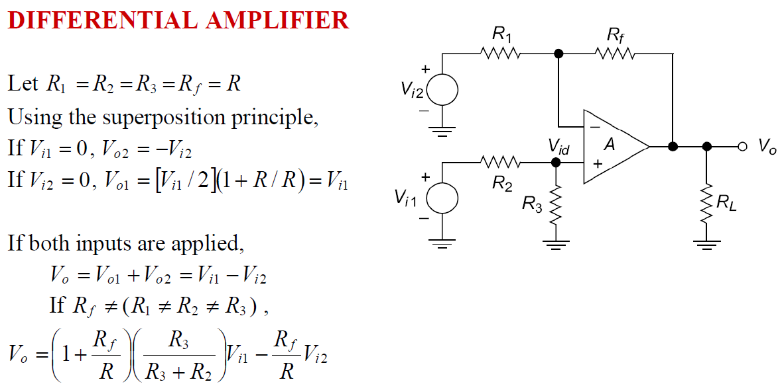

Slide 68
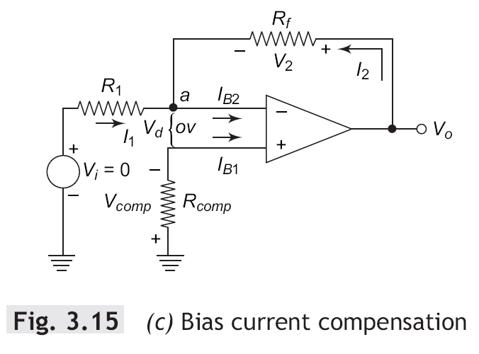
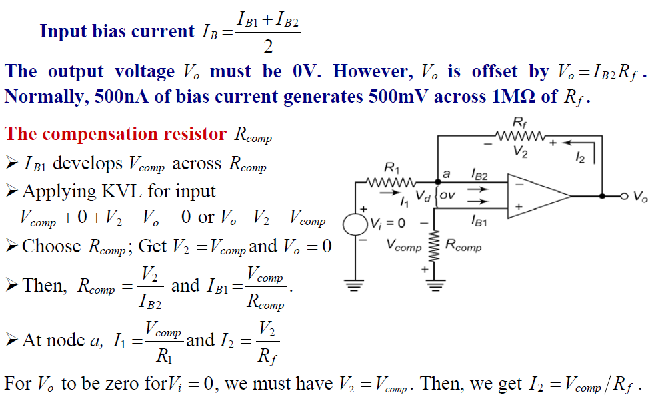
Bias Current Compensation

Slide 69
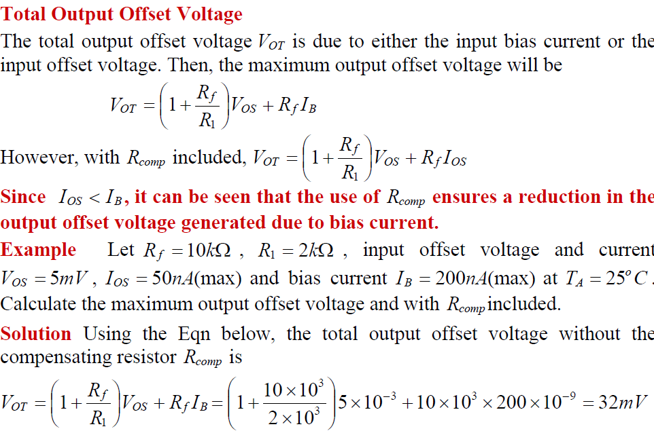
Finding Maximum or total Output Offset Voltage due to bias current and Input offset Voltage

Slide 70
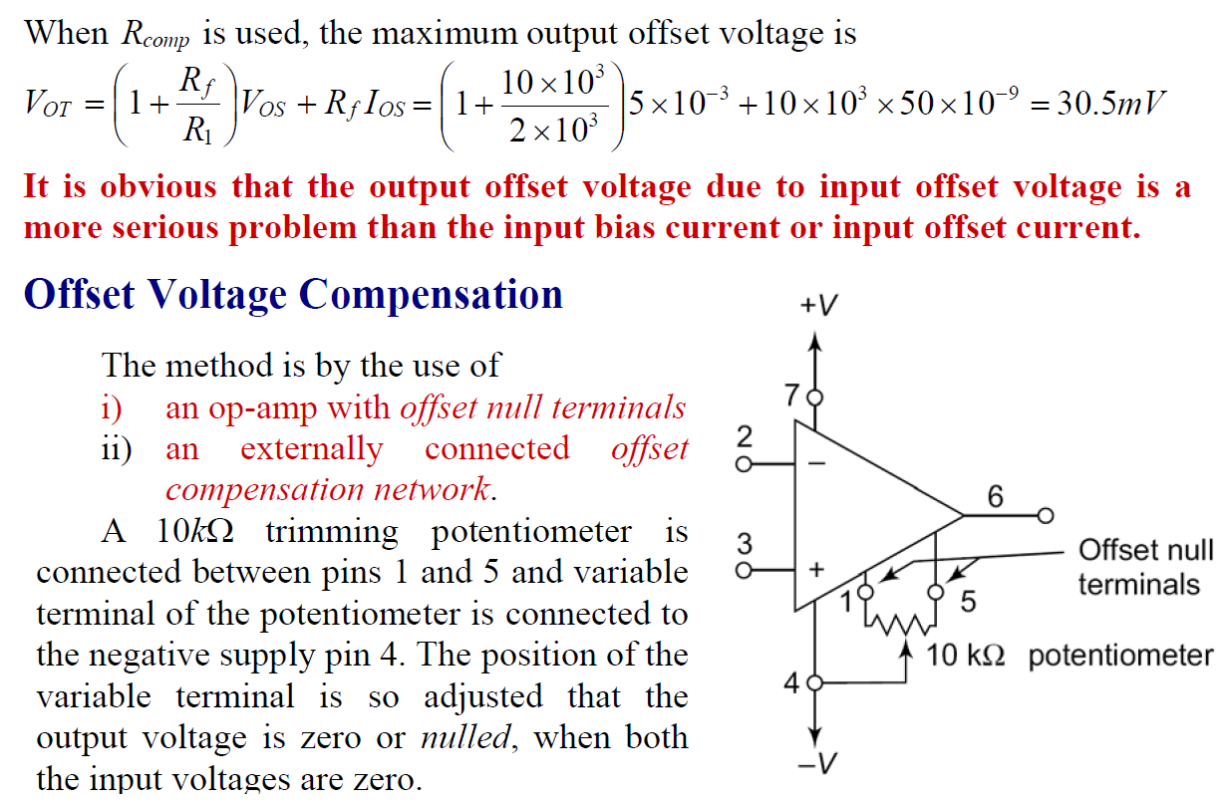
Maximum output offset voltage with Rcomp

Slide 71
Offset Voltage Compensation for Op Amp
The two methods
Op Amp with offset null terminal
Providing externally connected offset compensation network

Slide 72
Op Amp with offset null terminal
A 10 K trimming potentiometer is connected between
Offset null pins 1 and 5.

Slide 73

Output Offset Nulling Procedure

Slide 74

Drift in Op-Amp Parameters
Op Amp input offset voltage ,Bias currents and offset currents are function of following.
Change in temperature $∆T$
Change in supply voltage
Change in time
Change in Op-amp parameters with respect to above is called as drift.

Slide 76

Practice Problems
Problem1

Slide 77
Problem1 solution

Slide 78
Problem2

Slide 79
Problem 3

Slide 80
Problem 4
Problem 5

Slide 81

Problem 6
$A_{V}=−\frac{R_{f}}{R_{1}}$ =- $\frac{4.7K}{470Ω}$ = -10
Problem 7

Slide 82
Problem 8
Problem 9

Slide 83
37.Assuming slew rate for Op-amp IC 741 is 0.5V/µsec , what is the maximum undistorted sine-wave that can be obtained for 2V input?

Slide 84
Assuming slew rate for LF 356 is 12V/µsec , what is the maximum undistorted sine-wave frequency that can be applied for 1V input.

